Slide 1

Assessment for the World of Work
D5-S1

Slide 2
Session Outcomes By the end of the session the participants should:
Understand the meaning and operationalization of Assessment for the world of work.
Identify some of the possible employment opportunities available and what the world of work demands for the different occupations.
Appreciate the importance of Assessment for the world of work .

Slide 3
Activity 1
Study your subject Syllabus, choose one topic and explain what it can help you to do in the world of work.
Identify the critical skills in the occupations chosen.
Notes:
It is very important that learners appreciate the rationale for whatever they study and there by being able to the relate it to the world of work.

Slide 4
Activity 2
In your groups:
1.Discuss what you understand by ‘Assessment for the world of work.
2. Which body is to conduct assessment for world of work and when?
3. Identify the Subjects so far earmarked for Assessment for the WoW.

Slide 5
Understanding Assessment for the World of Work
This is a form of assessment provided for in the New Competence based Curriculum to examine the learner’s employability skills.
Assessment for the WoW is to be carried out by the Directorate of Industrial Training(DIT).

Slide 6
Activity 3
Which occupations can learners get after studying any of the subjects on the LSC?
Identify the critical skills in any one of the mentioned occupations.

Slide 7
The 8 vocational subjects in the New Curriculum
Agriculture
Art and Design
Entrepreneurship
Information and Communication Technology [ICT]
Nutrition and Food Technology
Performing Arts
Physical Education
Technology and Design

Slide 8
Explanation
Focus for the assessment will be on competences for the world of work
The DIT will then award a certificate to candidates indicating the module in which they will have been assessed.

Slide 9
Activity 4
From the syllabus provided, identify possible topics that can enable the learner acquire an occupation.
Share in plenary

Slide 10
DIT Modules
Each of the pre-vocational subjects has topics to be assessed as modules at the end of senior 3 by DIT.
Focus will be on competences for the world of work
DIT will then award a certificate to candidates indicating the module

Slide 11
Activity 5
In your groups,
Discuss the benefits of Assessment for the world of work to the learner and the country?
Present in a plenary

Slide 12
Activity 6
Use the straws provided to make the possible tallest pole to hold the national flag.
What have you learnt from this exercise?

Slide 13
Reflection
Where in life do we have teamwork?

Slide 14
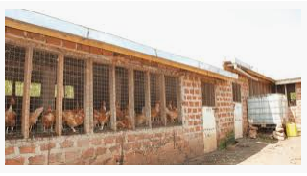
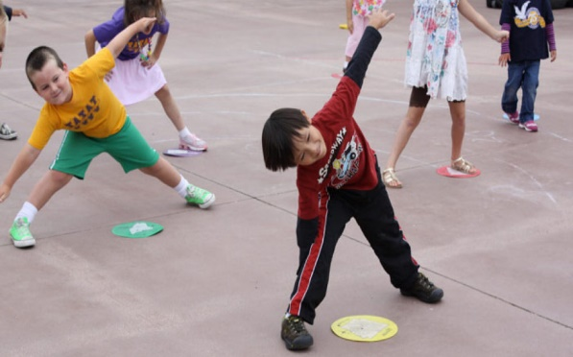
Wrap up
Assessment should focus on the mastery of skills needed for and are competitive in the marketplace.
DIT
DIT does the Assessment

Slide 15
Thank you

